Slide 1


CREDENTIALS / 2026
Human judgement
for an AI-shaped world.
STRATEGY · AI · LEADERSHIP · COMMERCE
From decision to implementation.
01
Notes:
[Sources]
- https://brandhere.co/
- Brand Here owned image asset

Slide 2

POINT OF VIEW / 01
Intelligence
is abundant.
Judgement
is human.
AI helps us see more and test faster. Someone still has to choose what matters—and own the consequences.
02
Notes:
[Sources]
- https://brandhere.co/

Slide 3
PROOF BEFORE PROMISE
Built in the real world.
80+
50+
30+
4
PROJECTS DELIVERED
CORPORATE CLIENTS
BRANDS MANAGED
CONSECUTIVE YEARS ABOVE PLAN
03
Notes:
[Sources]
- https://brandhere.co/
- https://brandhere.co/about.html

Slide 4
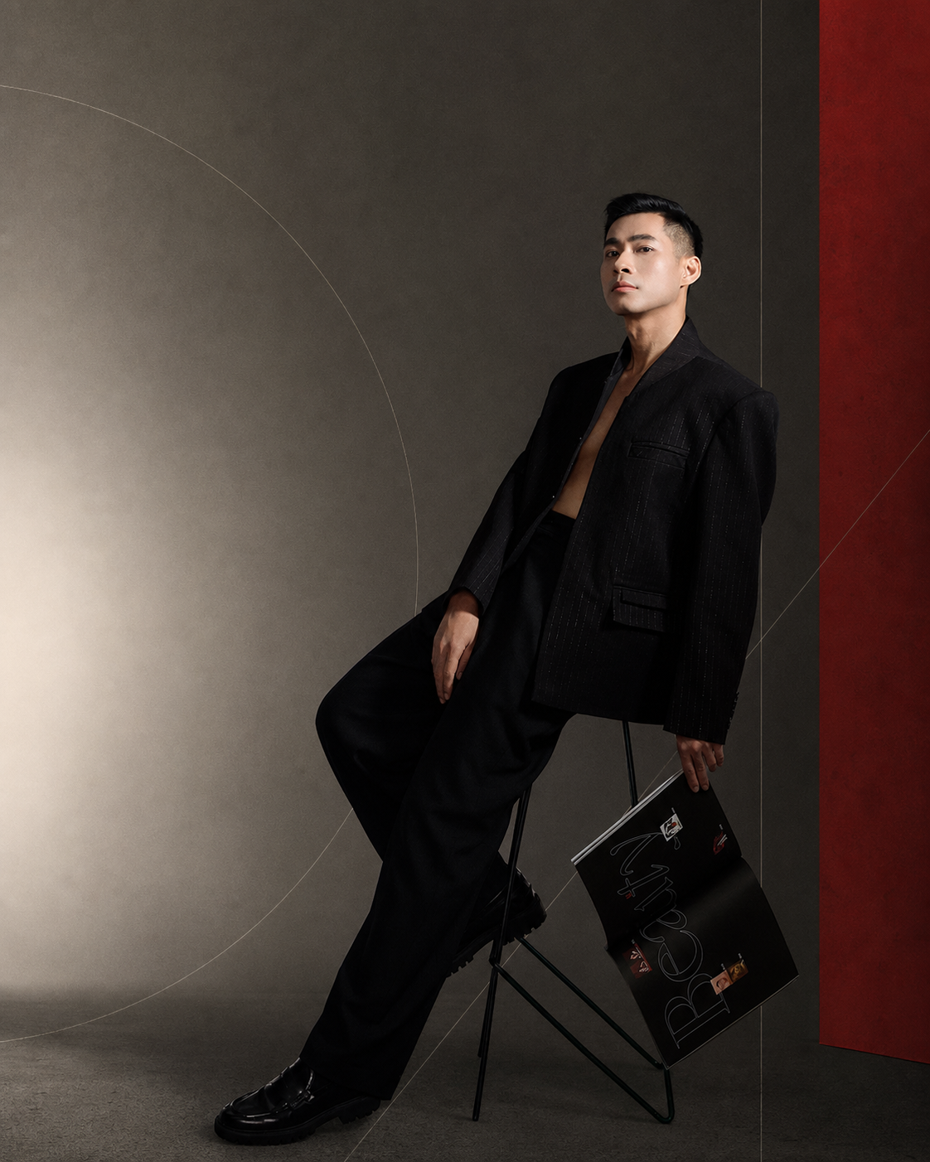
THE COMPANY
Consulting-led.
Expert-backed.
Partner-enabled.
Brand Here defines the problem, leads the strategic direction and assembles the specialist capabilities each assignment actually needs.
04
Notes:
[Sources]
- https://brandhere.co/about.html
- Brand Here owned portrait

Slide 5
FOUR WAYS TO MOVE
Start with the decision.
Not the deliverable.
01
STRATEGY CONSULTING
Choose where to play—and what not to do.
02
AI TRANSFORMATION
Turn experiments into useful systems.
03
EXECUTIVE BRANDING
Build a leadership narrative people can trust.
04
COMMERCE & MARKET EXPANSION
Test the economics before scaling.
05
Notes:
[Sources]
- https://brandhere.co/what-we-do.html

Slide 6
STRATEGY CONSULTING / 01
Make the choice
coherent.
TYPICAL OUTCOMES
01
Positioning and strategic choice
02
Go-to-market direction
We clarify the market, the strategic edge and the decisions that must align before execution begins.
03
Decision roadmap
06
Notes:
[Sources]
- https://brandhere.co/what-we-do.html

Slide 7
AI TRANSFORMATION / 02
Useful systems.
Human owners.
TYPICAL OUTCOMES
01
AI readiness and use-case priorities
02
Decision-support tools
We connect AI possibilities to a measurable business consequence, responsible data handling and an accountable operating owner.
03
Adoption roadmap and governance
07
Notes:
[Sources]
- https://brandhere.co/what-we-do.html

Slide 8
EXECUTIVE BRANDING / 03
Leadership made
credible.
TYPICAL OUTCOMES
01
Leadership positioning
02
Narrative and content system
We turn expertise, point of view and public presence into a coherent leadership brand—not a manufactured persona.
03
Visibility and reputation plan
08
Notes:
[Sources]
- https://brandhere.co/what-we-do.html

Slide 9
COMMERCE & EXPANSION / 04
Test before
you scale.
TYPICAL OUTCOMES
01
E-commerce strategy
02
Channel and market validation
We connect channel choices, unit economics and operating reality before committing to growth.
03
Commercial operating roadmap
09
Notes:
[Sources]
- https://brandhere.co/what-we-do.html

Slide 10
HOW WE WORK
One direction.
The right team.
01
02
03
BRAND HERE
EXPERTS
PARTNERS
Strategic lead
Decision depth
Delivery capability
Problem definition · direction · quality
Governance · finance · technology · commerce
AI · production · CGI/VFX · market execution
10
Notes:
[Sources]
- https://brandhere.co/partners.html
- https://brandhere.co/experts.html

Slide 11

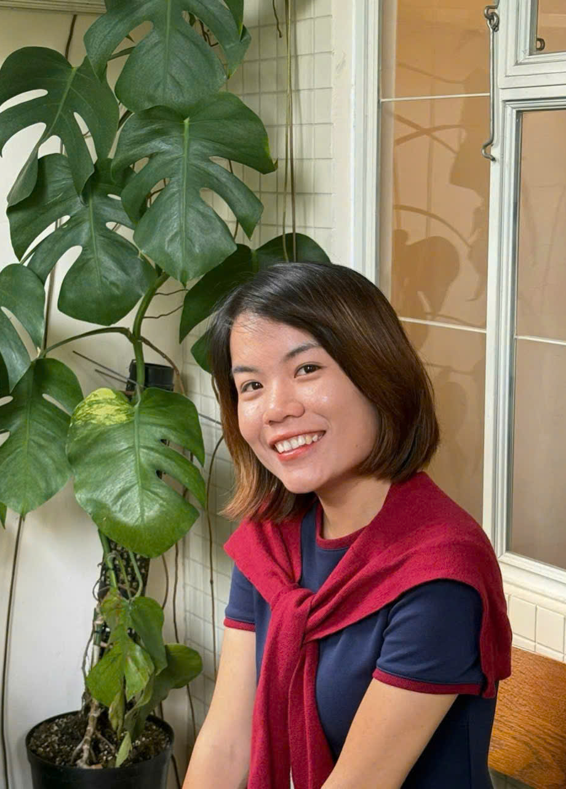
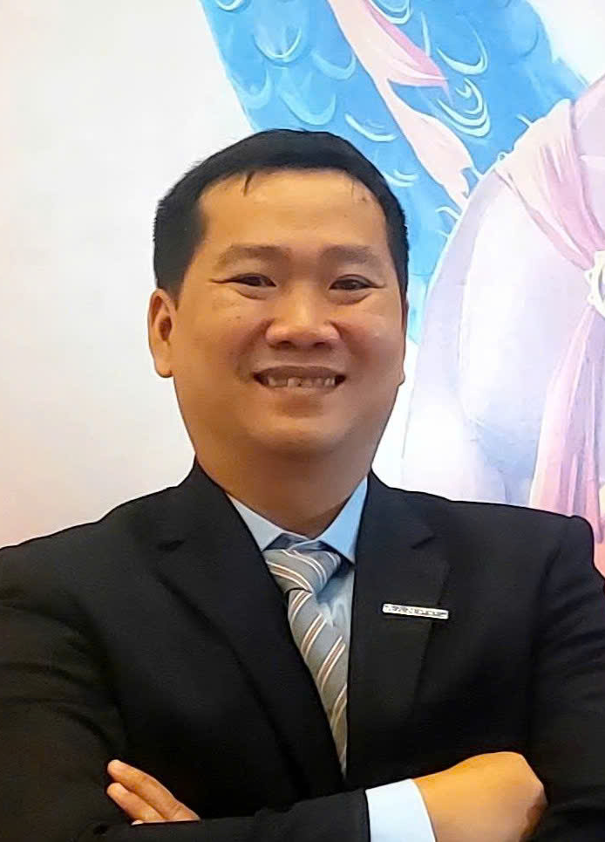
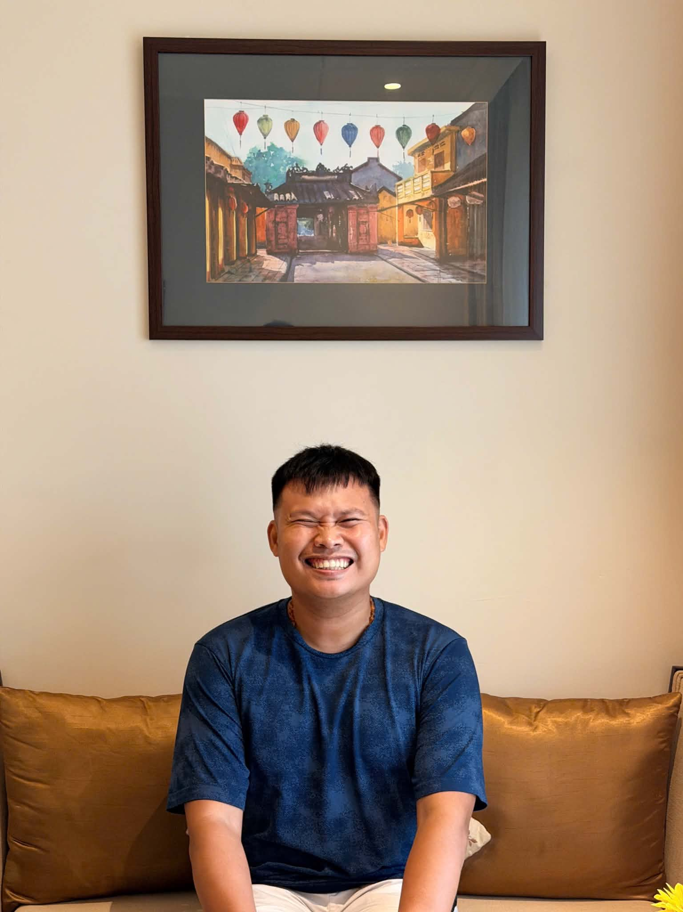

EXPERT NETWORK
Experience has a face.
La Pham
Khanh Cao
Vu Dinh
Nam Tran
Dung Dinh
TECHNOLOGY / SYSTEMS
COMMERCE / GROWTH
GOVERNANCE / COMPLIANCE
FINANCE / VALUE
TECHNOLOGY / PLATFORMS
11
Notes:
[Sources]
- https://brandhere.co/experts.html
- Brand Here expert portraits

Slide 12
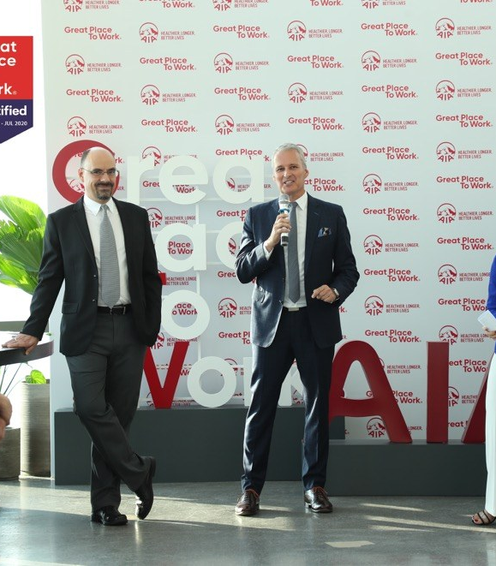
SELECTED WORK / AIA
Six days.
Full press
attendance.
100%
INVITED MEDIA ATTENDANCE
12
Notes:
[Sources]
- https://brandhere.co/work.html
- Brand Here owned case-study image

Slide 13
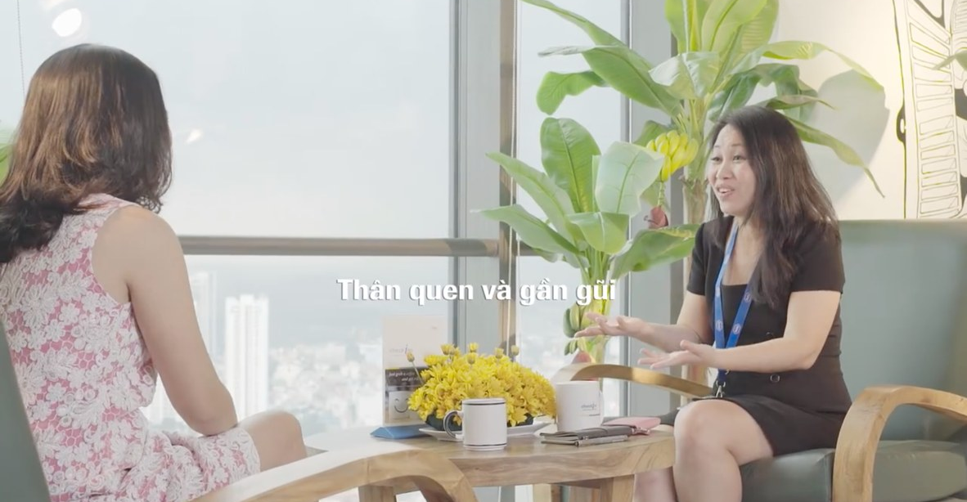
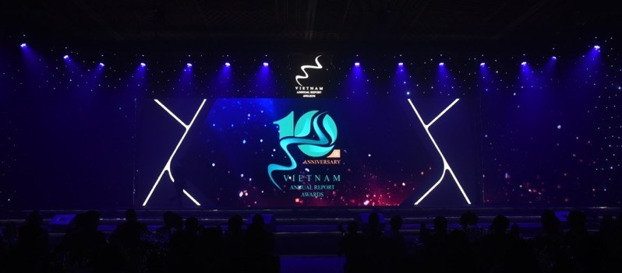
SELECTED WORK
Real conditions.
Visible outcomes.
ROCHE / REAL EMPLOYEE VOICES
DRAGON CAPITAL / A DECADE MADE TANGIBLE
13
Notes:
[Sources]
- https://brandhere.co/work.html
- Brand Here owned case-study images

Slide 14
PARTNER ECOSYSTEM
Specialist delivery,
without losing direction.
NYMPHEA AI AGENCY
POPCORN MEDIA
AI agents · automation · integration
Full-service production
HYPER CRICKET
WANDERSTAR FILM.ART
CGI · VFX · post-production
Film · visual art
14
Notes:
[Sources]
- https://brandhere.co/partners.html
- https://www.nympheaaiagency.com/
- https://popcornmedia.vn/
- https://hypercricket.vn/

Slide 15
THE NEXT DECISION
Bring us one
real question.
Senior judgement. A direction you can act on.
brandhere.co
tuan.nguyen@brandhere.vn
+84 907 255 734
INSIGHT TO IMPACT
15
Notes:
[Sources]
- https://brandhere.co/contact.html

